Slide 1
Cse 485 Datamining
Introduction to Data Science
And Machine Learning

Slide 2
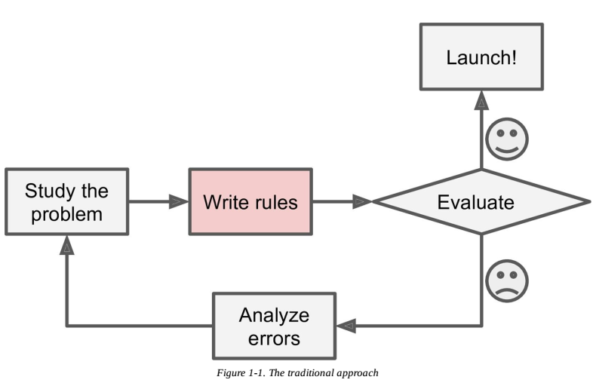
Traditional Solution

Slide 3
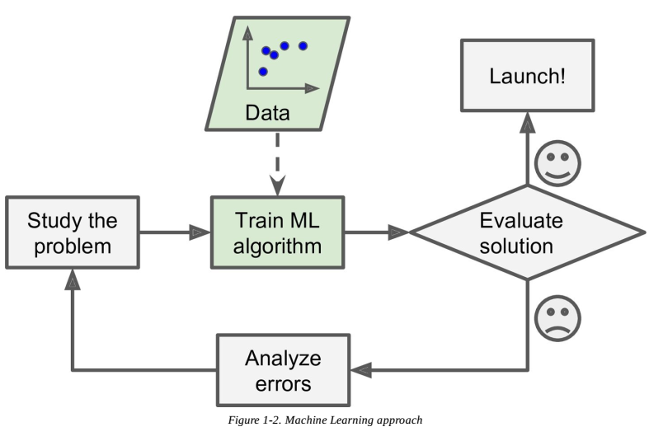
ML in the Loop

Slide 4
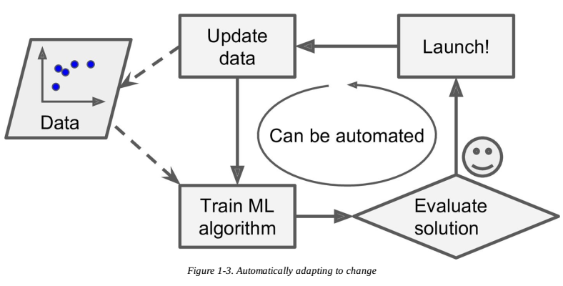
Adapt to changes

Slide 5
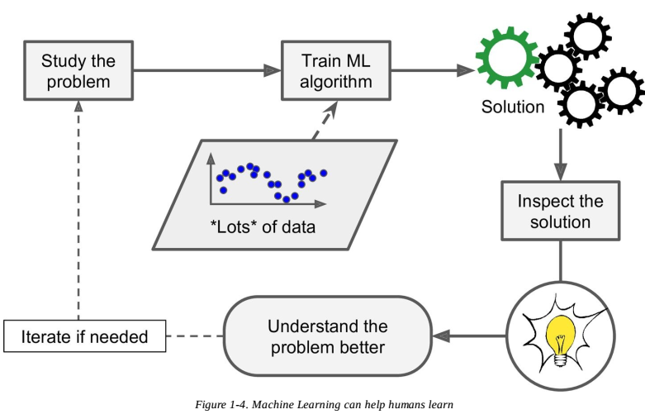
ML Analysis + Human Analysis

Slide 6
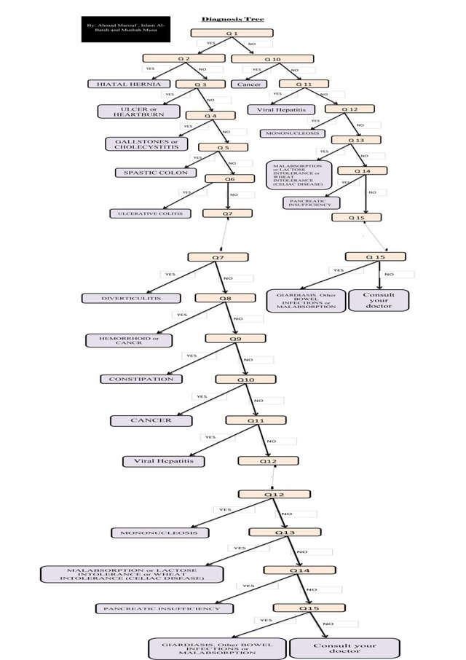
Example Stomach Pain

Slide 7
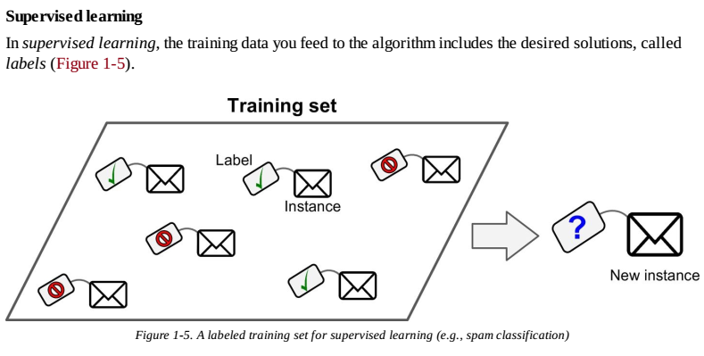
Supervised Learning
CLASSIFICATION

Slide 8
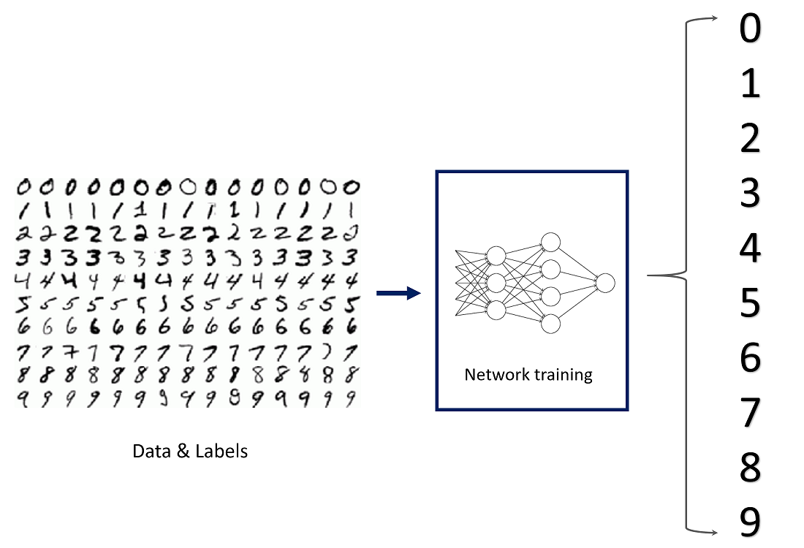

Example Character Recognition

Slide 9
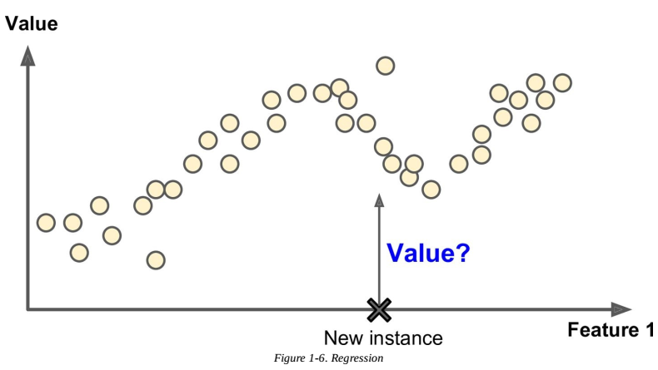
Regression

Slide 10
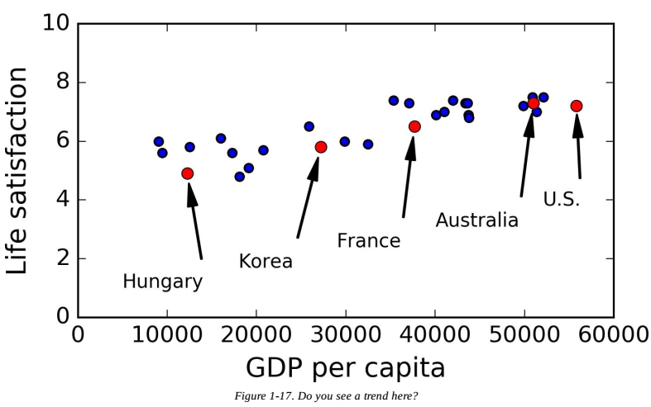
Example Regression
GDP vs Satisfaction

Slide 11
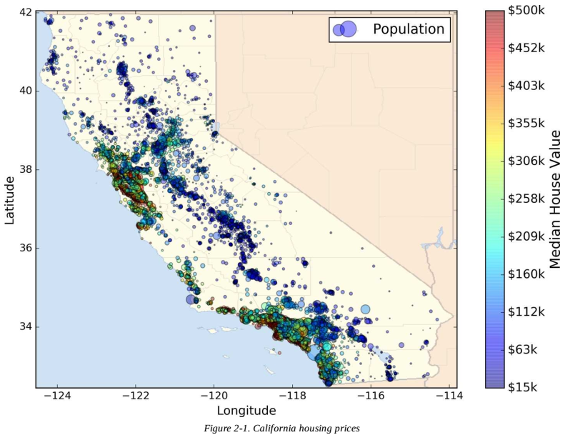
Housing Price

Slide 12
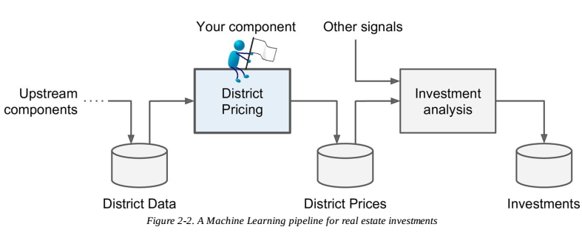
Example Regression
House Pricing

Slide 13
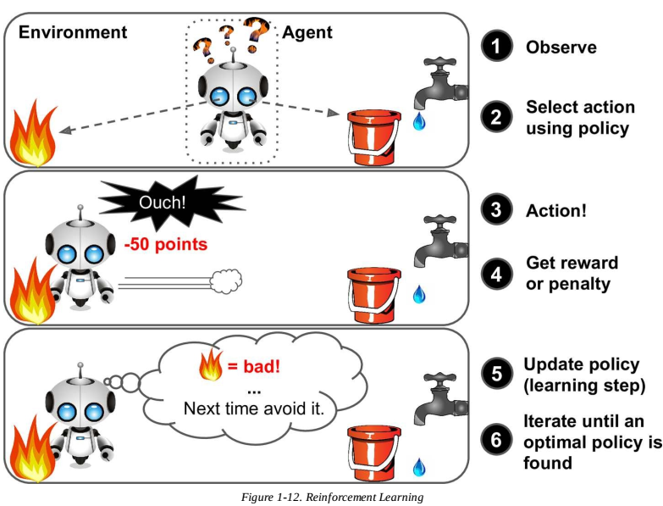
Reinforcement Learning

Slide 14
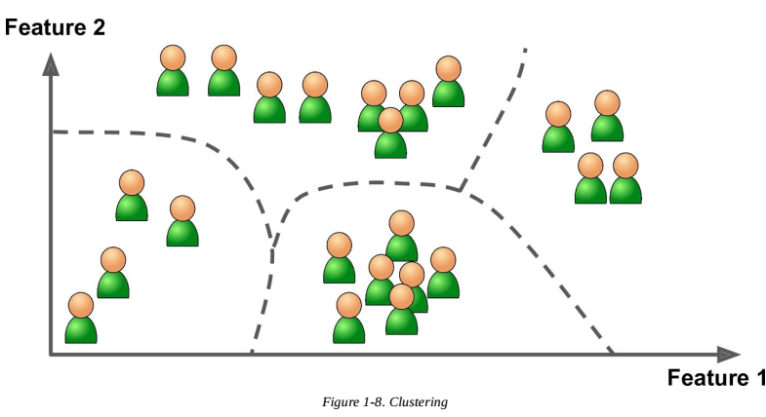
Unsupervised Learning
CLUSTERING

Slide 15
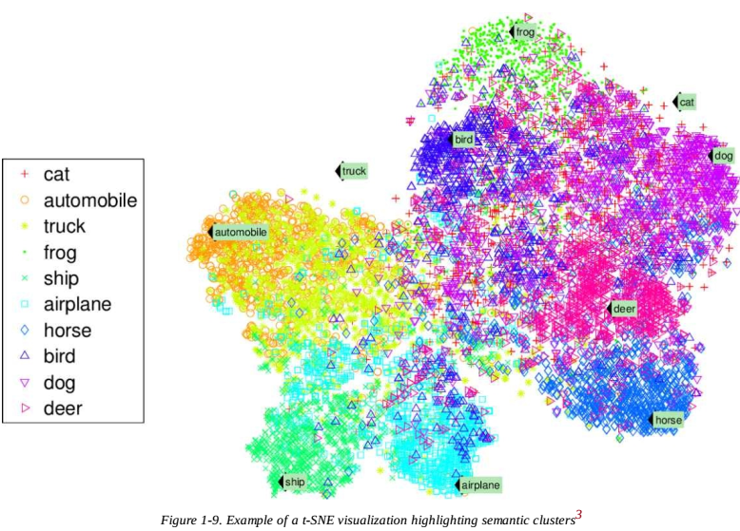
Dimensıonality Reduction

Slide 16
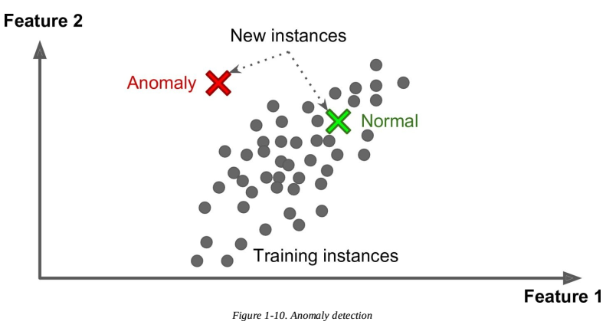
Anomaly Detection
Can be supervised/ unsupervised

Slide 17
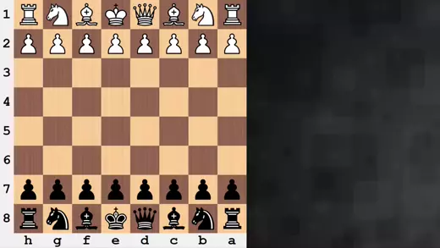
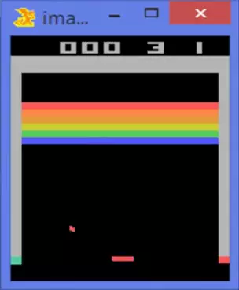
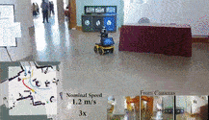
Reinforcement Learning

